Slide 1

GoF Observer vs. MVC vs. MVP
By Luke Yang
Software Architect

Slide 2
Agenda
What is Observer Pattern ? (approx. 10 min.)
Sample: Observer Pattern with Borland Together(approx. 10 min.)
Sample: Observer Pattern with .NET Delegate&Event (approx. 10 min.)
Q&A
What is Monolithic and its Pros and Cons? (approx. 5 min.)
Sample: Monolithic (approx. 5 min.)
Sample: Acceptance Test with NUnitForm (approx. 15 min.)
Q&A
Break(approx. 20 min.)

Slide 3
Agenda
What is MVC and its Pros and Cons?(approx. 10 min.)
Sample: How to refactor a view to MVC?(approx. 20 min.)
Q&A
What is MVP and its Pros and Cons?(approx. 10 min.)
Sample: How to refactor a view to MVP?(approx. 20 min.)
Sample: Unit Test with MVP?(approx. 10 min.)
Q&A

Slide 4
What is GoF Observer Pattern?
Intent
  Define a one-to-many dependency between objects so that when one object changes state, all its dependents are notified and updated automatically.
Also Known As
  Dependents, Publish-Subscribe

Slide 5
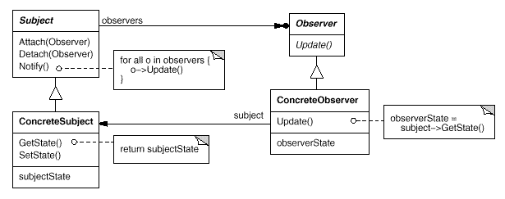
What is Observer Pattern?
Key objects: subject and observer.
A subject may have any number of dependent observers.
All observers are notified whenever the subject undergoes a change in state.
In response, each observer will query the subject to synchronize its state with the subject's state.

Slide 6
What is Observer Pattern?
Pub-Sub: one of the primary integration patterns
MVC - Smalltalk
MVP – Taligent C++ & Dolphin Smalltalk

Slide 7
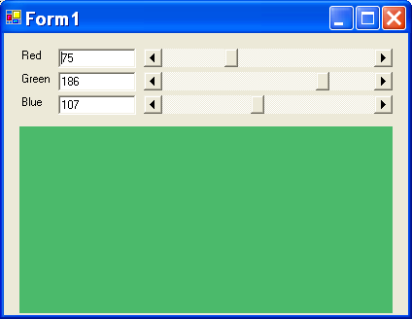
How to use Observer Pattern?
Observer2
Observer1
public class ConcreteSubject : Subject
{
……
public int Red { get; set; }
public int Green { get; set; }
public int Blue { get; set; }
……
}
Observer3
Example: ObserverSample

Slide 8
How to use Observer Pattern?
Event - build-in Observer in .NET
  Public Event OnClick(sender As Object, args As EventArgs)
  Public Delegate Sub OnClickEventHandler(sender As Object, args As EventArgs)
  Public OnClickEventHandler OnClick
  RaiseEvent OnClick(Me, New EventArgs())
Example: ObserverSampleEvent

Slide 9
Q&A

Slide 10
What is Monolithic?
In a monolithic, programmers put all the logics including UI, business and data access into one form.
Good for toy systems and prototyping.

Slide 11
Monolithic Pros and Cons?
Pros:
  Convenient for small project.
  If you are prototyping, coding in that way is fast and efficient.
  Best way to kill yourself in a real project.
Cons:
  The complexity will explose when the size of the domain become bigger.
  Difficult to reuse code.
  Difficult to test.
  Difficult to maintain.

Slide 12
Monolithic Example?
Example: Monolithic

Slide 13
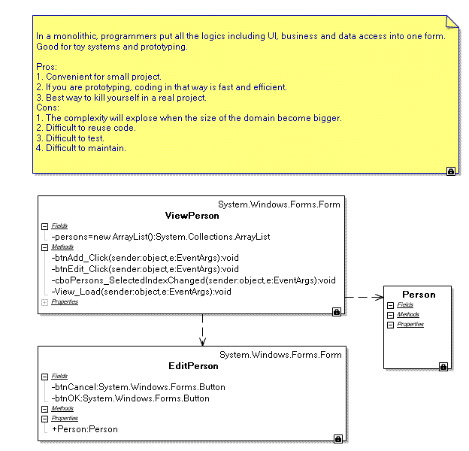
DTO

Slide 14
Test Example?
Example: Acceptance Test with NUnitForm

Slide 15
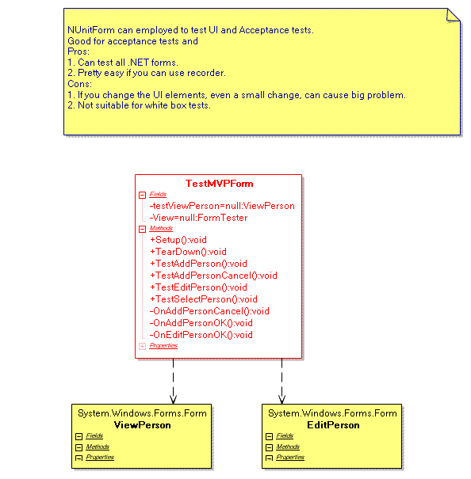

Slide 16
What should we do with monolithic?

Slide 17
What is MVC?
Subject
Observer
notify
Update()
Model
View
notify
update
Controller
Model hold the data.
View display the data.
Controller update the data.

Slide 18
What is MVC?
Put UI and UIP logic in a form.
Put business logic and data access logic in a Controller(actually not really).
Good for big projects where UI is simple and less logic.

Slide 19
MVC Pros and Cons?
Pros:
  The complexity will keep competitively static when the size of the domain become bigger.
  Clear responsibilities.
  Easier to reuse code.
  Easier than Monolithic to test.
  Easier to maintain.
Cons:
  Hard to test UI components.
  If you have multiple UIs, you have to rewrite most logic in the views.

Slide 20
Refactor a view to MVC
Should first have test scripts to make sure your refactoring won't change the behavior.
Extract the code that handling business logic or data logic and put them in properties or methods.
Create a controller and move all those methods to the controller.
Instantiate a controller in the view’s constructor.
Redirect preceding methods to the controller.

Slide 21
Example: Refactor a view to MVC
Example: MonolithicRefactored

Slide 22
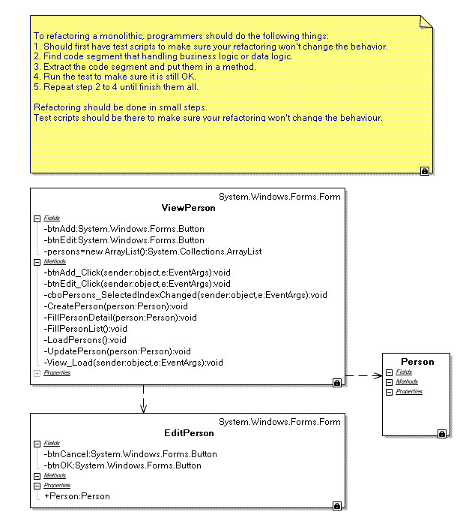
Business & Data access
DTO

Slide 23
Example: Refactor a view to MVC
Example: MVC

Slide 24
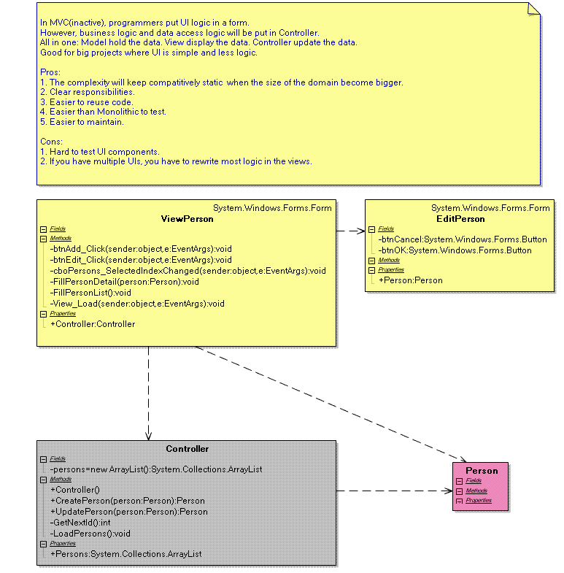
Business & Data access
Domain

Slide 25
Q&A?

Slide 26
What is the problem of MVC?
Cons:
  Hard to test UI components.
  If you have multiple UIs, you have to rewrite most logic in the views.

Slide 27
What is the problem of MVC?
Model
View
notify
update
Controller
What a View can do:
  Display data – UI Controls.
  Interpret user interactions - EventHandlers.
  Validations - EventHandlers.

Slide 28
How to decouple UI and UIP? - GoF Proxy!!!
Client
Proxy
Subject
RealSubject
Provide a surrogate or placeholder for another object to control access to it.

Slide 29
How to decouple UI and UIP? - GoF Proxy!!!
event handlers
Abstraction of controls & event sources
Presenter(Client)
IView(Proxy)
View(RealSubject)
MockView(Subject)
controls & event sources

Slide 30
What is MVP?
Acceptance Tests
Unit Tests
View
MockView
UI controls & event sources
UI
UIP
IView
Abstract of UI controls & event sources
Model(Domain)
Presenter
event handlers
notify
update
Controller

Slide 31
What is MVP?
Separates the behavior of the presentation out into a separate presenter class.
  User events are forwarded to the presenter
  The presenter manipulates the state of the view.
Allows the behavior to be tested without the UI
Different UI controls to be used with the same basic behavior.
http://www.martinfowler.com/eaaDev/ModelViewPresenter.html

Slide 32
MVP Pros and Cons?
Pros:
  The complexity will keep competitively static when the size of the domain become bigger.
  Clear responsibilities.
  Easier to reuse code. Especially the code in UIP when you have multiple UIs.
  Easier than MVC to test.
  Which is the base of many future UI frameworks.
Cons:
  Hard to test UI components.
  More code need to be maintained than in MVC.

Slide 33
Refactor a view to MVP
Should first have test scripts to make sure your refactoring won't change the behavior.
Create an interface of IView type
Wrap all UI controls and event sources with properties or methods and add them in the preceding interface.
Create AddEventHandler(handler) methods for each event handlers and add them in the preceding interface
Create a presenter and move all event handlers to the presenter.
Call all AddEventHandler(handler) in the presenter’s constructor.
Instantiate a presenter in the view’s Load event handler(or constructor).
Refactoring all event handlers using the interface instead of the view.

Slide 34
Example: Refactor a view to MVP
Example: MVCRefactored

Slide 35
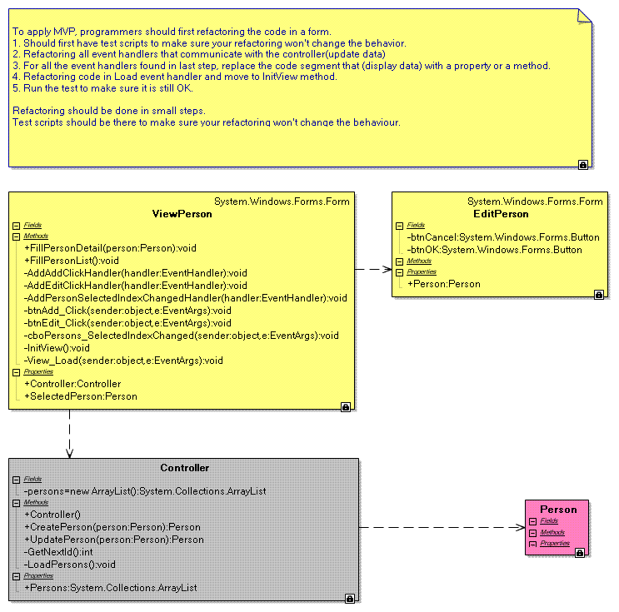
UI Controls to IView
Add Event Handlers to IView
Event Handlers to Presenter
InitView to Presenter

Slide 36
Example: Refactor a view to MVP
MVP Example: MVP

Slide 37
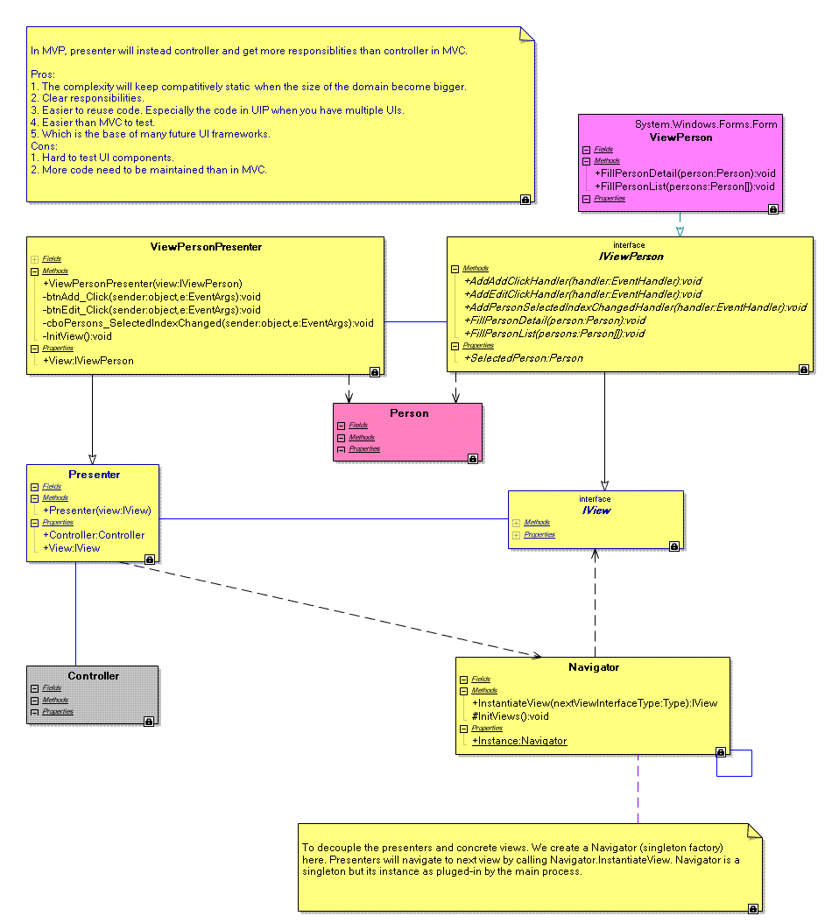
Layer Supertype
Presentation Chooser

Slide 38
Example: Unit Test with MVP?
MVP Unit Tests: Test.TestMVPUnit

Slide 39
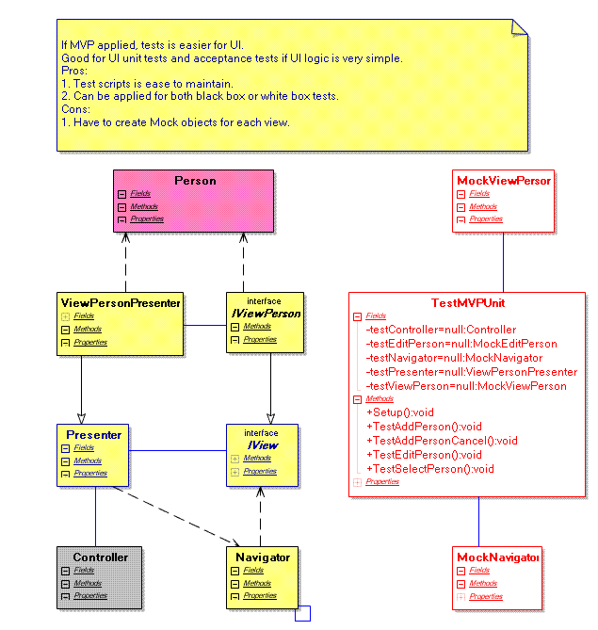
MockView
Test Presenter
MockDependants

Slide 40
Thanks for coming!
Next Presentation:
eService Client Side Architecture

